Slide 1
Design Patterns
Singleton & Factory Pattern
Eriq Muhammad Adams J.
Mail : eriq.adams@ub.ac.id | Blog : http://eriq.lecture.ub.ac.id

Slide 2
Singleton Pattern
ensures a class has only one instance, and provides a global point of access to it.

Slide 3
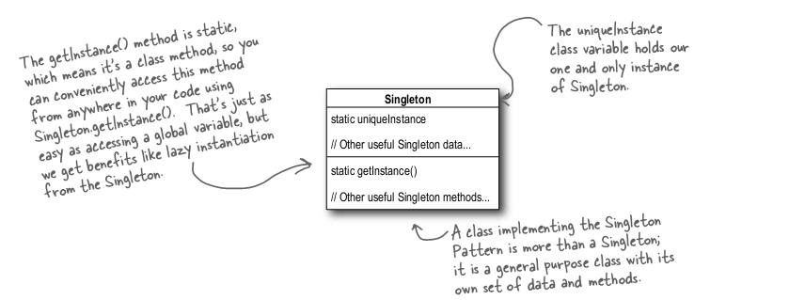

Singleton Pattern (cont.)

Slide 4
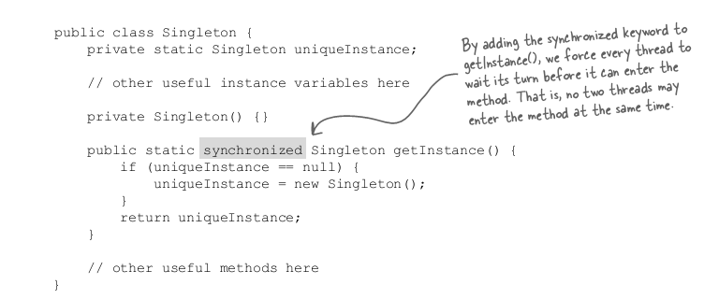
Singleton Pattern (cont.)
In multi-threading add synchronized to getInstance()

Slide 5
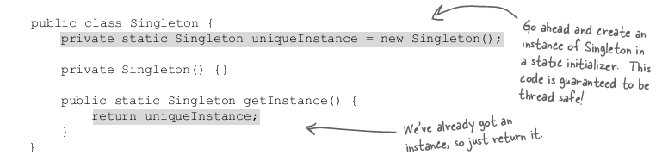
Singleton Pattern (cont.)
Or Move to an eagerly created instance rather than a lazily created one

Slide 6
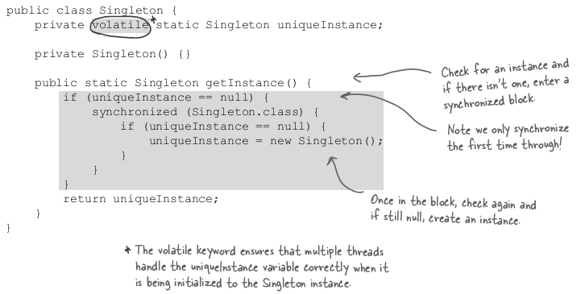
Singleton Pattern (cont.)
Use “double-checked locking” to reduce the use of synchronization in getInstance()

Slide 7
Factory Pattern
defines an interface for creating an object, but lets subclasses decide which class to instantiate. Factory Method lets a class defer instantiation to subclasses.

Slide 8
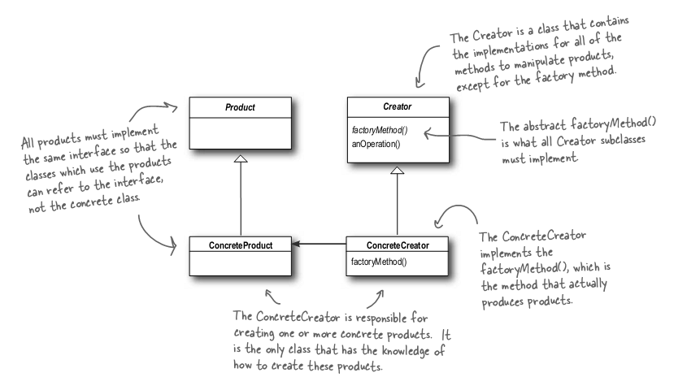
Factory Pattern (cont.)

Slide 9
References
O’Reilly – Head First Design Pattern by Eric Freeman & Elisabeth Freeman (2004).
CRC Press – Software Architecture Design Pattern in Java by Partha Kuchana (2004).

